Slide 1
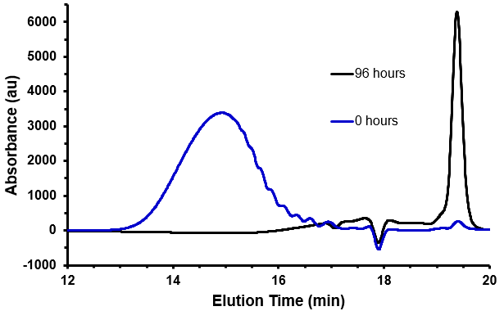
The Development of a Photodegradable Polyester
Bailey Phelps and Dr. Matthew Baker¹
¹ Department of Chemistry, State University of New York at Oswego, Oswego, NY
Introduction:
Plastics have become one of the most easily produced, utilized, and discarded products in the modern world. As production costs of plastics dropped, the amount of them found in landfills has grown drastically. In the United States alone, 38.5 million tons of plastic waste was produced in 2018 while only 9% of plastics were recycled.¹ This leaves millions of tons of plastic to either end up in landfills or pollute the environment. In response to this, many attempts have been made to develop degradable plastics and polymers.²
For degradable plastics to meet their full potential they should be designed to degrade selectively when exposed to a specific stimulus. In this context, a variety of stimuli have been explored for polymer degradation, including chemical, biological, mechanical, thermal, and photo-chemical means. Of these stimuli, arguably the most interesting is photochemical degradation because of the ease in which light can be controlled. For example, the duration, the intensity, and the wavelength of light can be easily modified providing a wider variety of control over the degradation process. This poster describes the development and analysis of a photo-degradable plastic.
Experimental:
Several sets of conditions were used in an attempt to synthesize the desired polymer. The most successful and consistent method involved thionyl chloride (scheme 1). To synthesize our polymer, 2-hydroxycinnamic acid (3) was refluxed in thionyl chloride overnight. Subsequently, the reaction mixture was concentrated, redissolved in tetrahydrofuran, and precipitated in methanol. The precipitate was filtered and dried resulting in polymer 1.
Scheme 1. Synthesis of poly(hydroxycinnamic acid)
Results and discussion:
After synthesis and purification, polymer 1 was analyzed by gel permeation chromatography (GPC). Using GPC we monitored the degradation of polymer 1 when exposed to UV light (figure 2). Upon exposure to 300 nm light, polymer 1 completely degraded over the period of 96 hours.
Subsequently, we characterized our polymer via ¹H NMR (figure 3a). Analysis of the spectra confirmed that the polymer was formed successfully. Depolymerization under UV-light was tracked yet again across a 96-hour period. After 96 hours the product of our experiment was characterized by ¹H NMR and determined to be coumarin, as expected (figure 3b).
Our goal:
The goal of this project was to develop and analyze a photodegradable plastic. To accomplish this task we focused on polymerizing 2-hydroxycinnamic acid and studying the plastic that resulted.
Hydroxycinnamic acid was chosen because it has the ability to respond to light and undergo a cyclization reaction, leading to the cleavage of adjoining bonds. As a result, when polymerized we hypothesized that our plastic would undergo degradation when exposed to light, leading to complete degradation of the plastic and the formation of coumarin as the product (figure 1).
Figure 3. Proton NMR spectra showing the conversion of polymer 1 (a) to coumarin (b), upon exposure to UV light.
Conclusion:
Synthesis of a photodegradable polyester was successful. Additionally, degradation studies were carried out proving our plastic was capable of completely degrading when exposed to UV light.
References:
Dell, J. U.S. Plastic Recycling Rate Projected to Drop to 4.4% in 2018, Environmental Protection Agency, 2018.
Mostafa, N.; Farag, A. A.; Abo-Dief, H. M.; Tayeb, A. M. Production of Biodegradable Plastic from Agricultural Wastes. Arabian Journal of Chemistry 2018, 11 (4), 546–553.
Figure 1. Image showing degradation of poly(hydroxycinnamic acid) (1) to form coumarin (2) when exposed to UV light.
Figure 3. GPC trace of our polymer before exposure (blue) and after 96 hours of exposure to 300 nm light (black).

